Slide 1


WealthHub

Slide 2

You're smarter than you think.
With our cutting-edge AI platform, you become:
Your own financial planner.
Analyzing your unique profile that fits you.
Not the victim for sales quotas.

Slide 3


Be Your Own I-Banker
- Skip the Fees
- Master Your Wealth
- Take Control

Slide 4
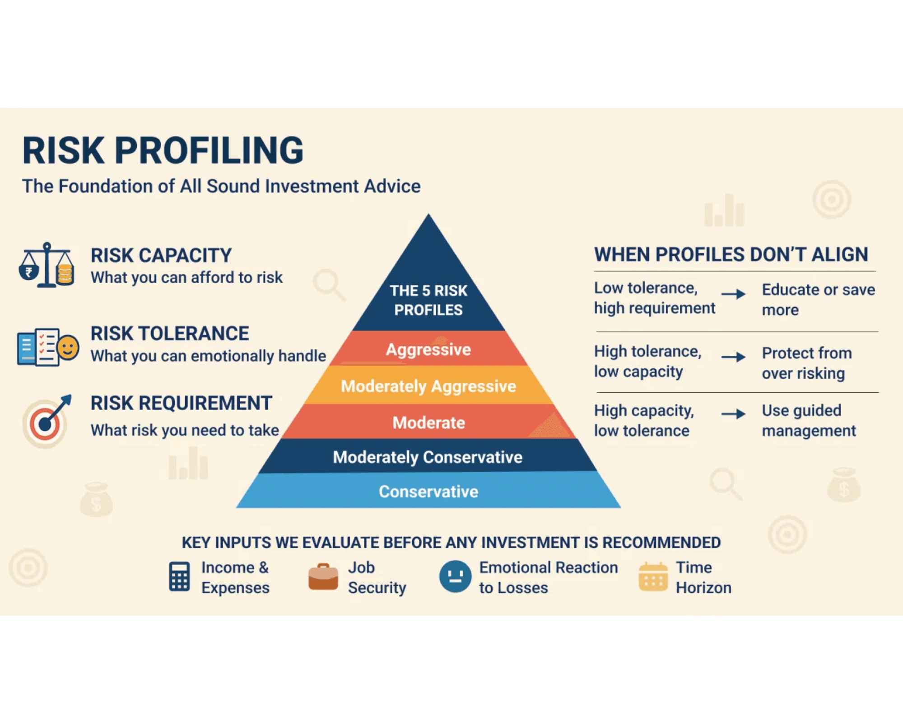
How It Works?
Who? Psychological Profiling
Are you optimistic, pessimistic, risk-averse, or aggressive? We define your investor DNA.
What? Social Demographic Analysis
Age, life stage, and family status are critical factors in tailoring your financial path.
When? True Investment Capacity
Calculating real investable capital after essential spending, not just gross income.
Where? Real-time Daily Insights
Know exactly where you stand with continuous monitoring and actionable data.

Slide 5

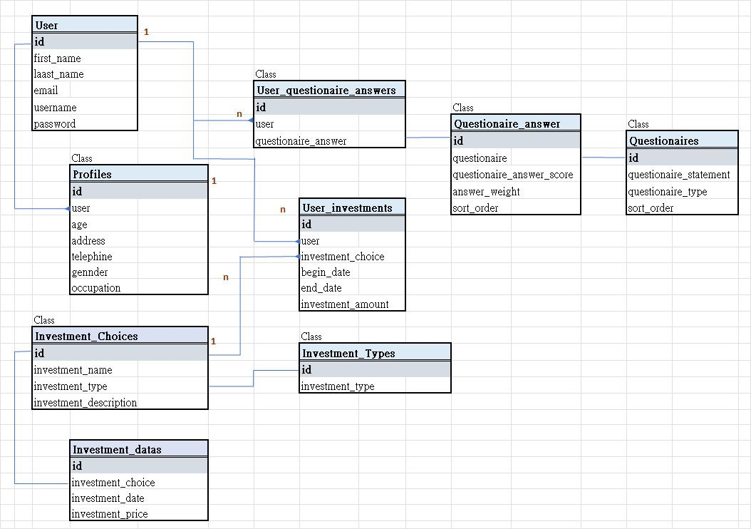
UML Class Diagram (ERD)

Slide 6

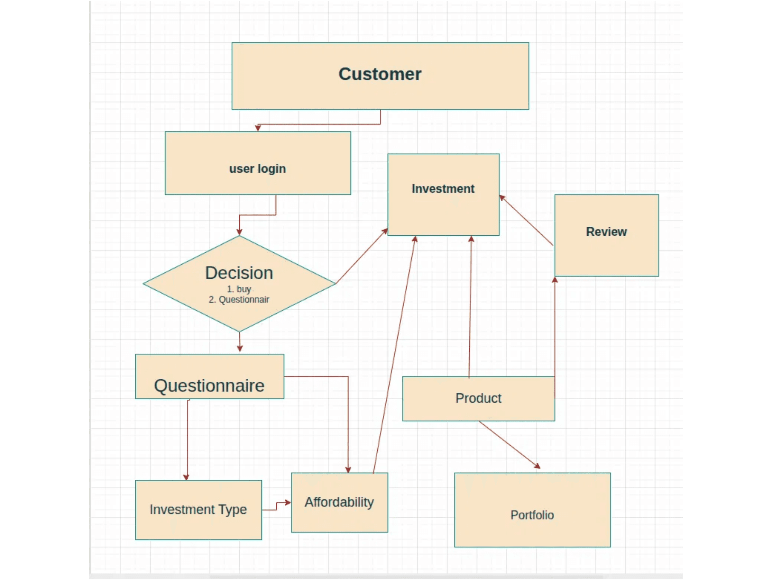
Process Flow: User Journey

Slide 7
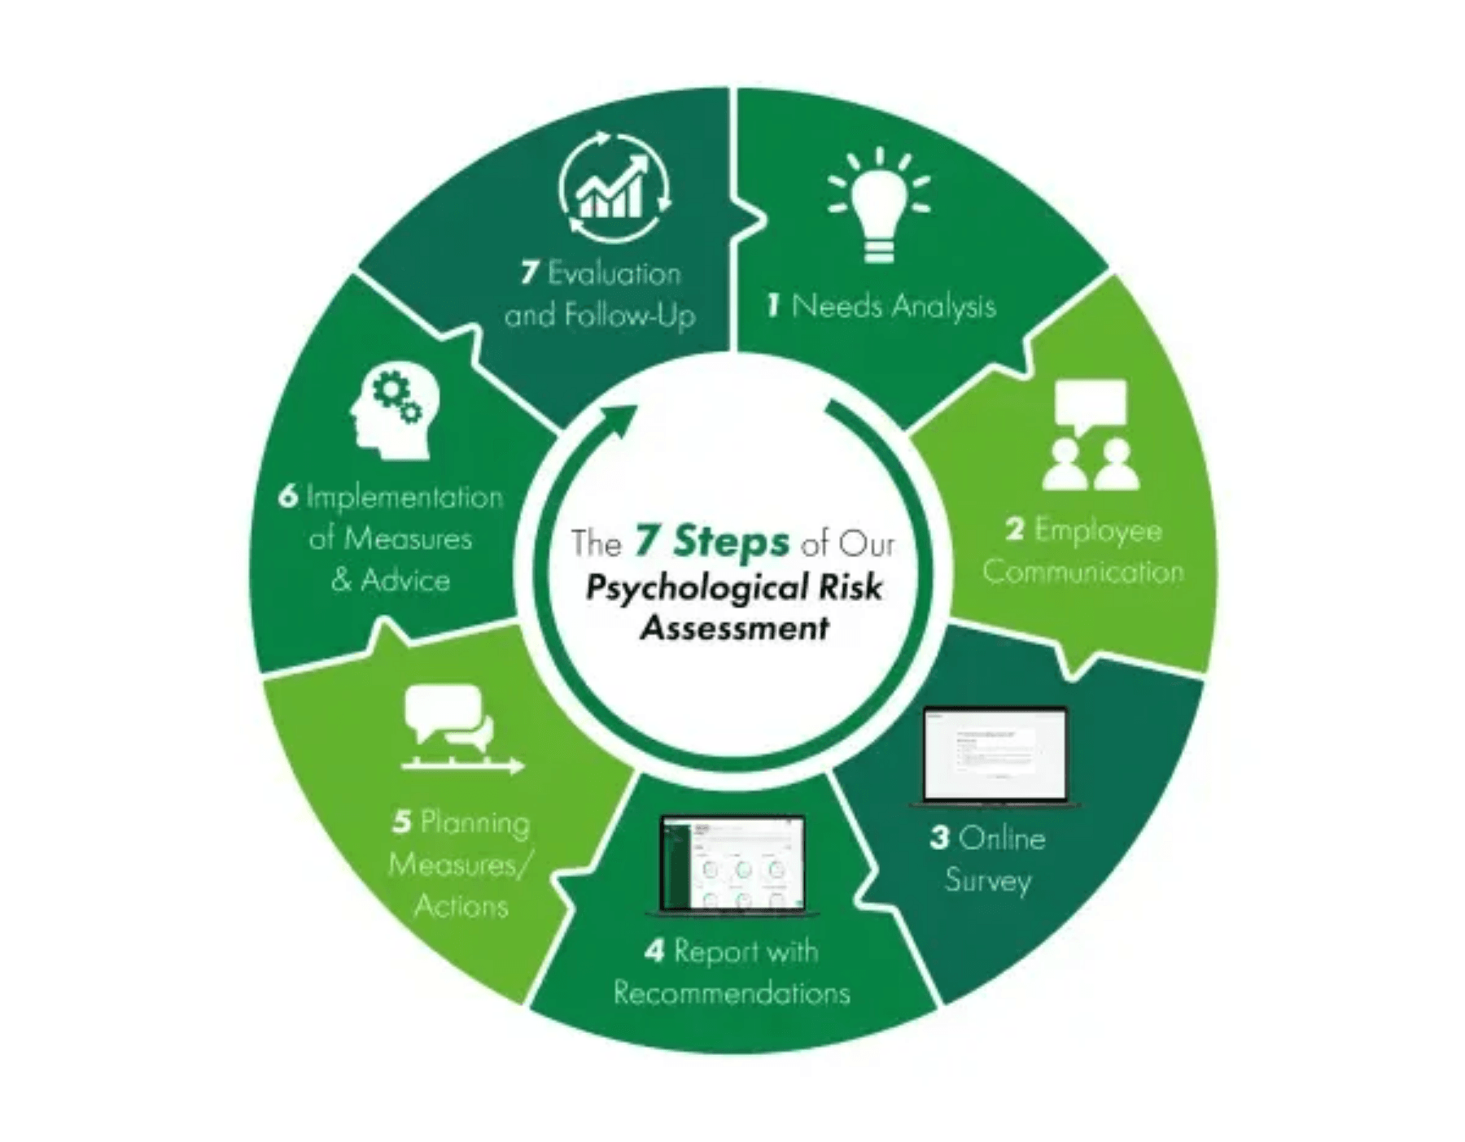
Getting Started: Simple Membership
1. Personal Profile
•
Quick and easy setup to establish your financial identity.
2. Financial Needs Analysis (FNA)
•
Mandatory for new life policies in Hong Kong.
WealthHub Advantage: Eliminates subjective manipulation through objective, data-driven analysis.
•
3. Life Orientation Test (LOT-R)
Revised assessment to understand your future orientation and psychological risk tolerance.
•

Slide 8
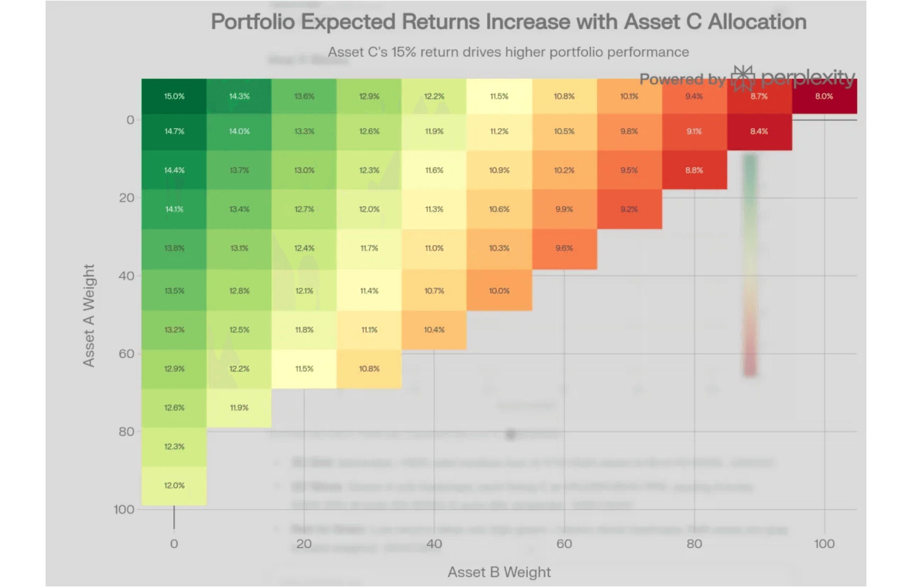
Demonstration of 4 Portfolios
Risk Level
Tailored risk assessment based on individual psychological profiling.
Return Compensation
Optimized returns relative to the selected risk appetite.
Duration
Strategic time horizons aligned with your life stage and goals.

Slide 9

Strategic Insights
Market Trend Analysis
Leveraging AI to identify emerging market shifts and volatility patterns before they impact your portfolio.
Portfolio Performance
Continuous monitoring of asset allocation to ensure alignment with long-term financial objectives and risk tolerance.
Data-Driven Decisions
Removing emotional bias from investment choices through rigorous quantitative analysis and real-time data feeds.

Slide 10
WealthHub
Skip the fees.
Master your wealth.
Take control.
Know Yourself.

Slide 11
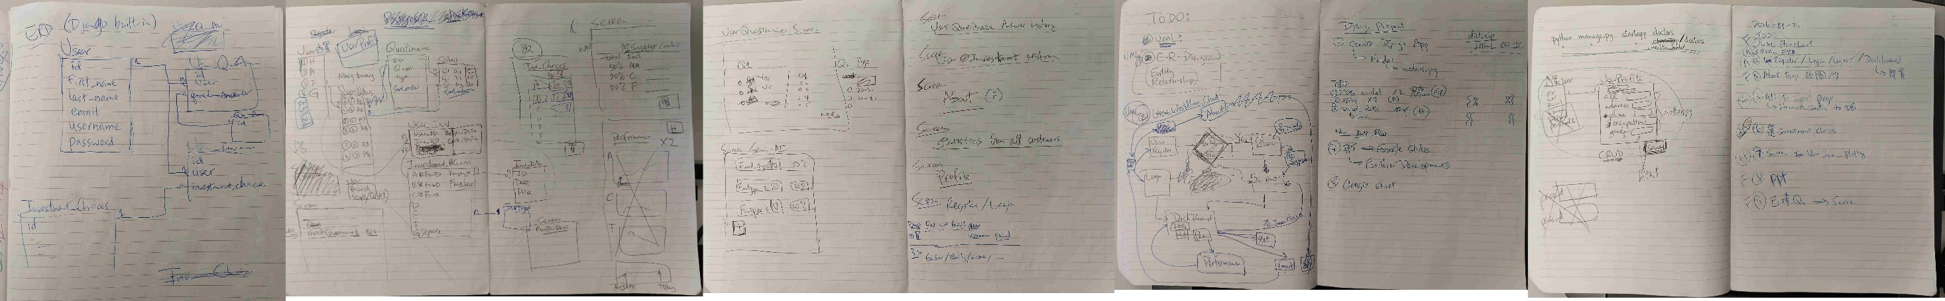
Idea's Creation

Slide 12
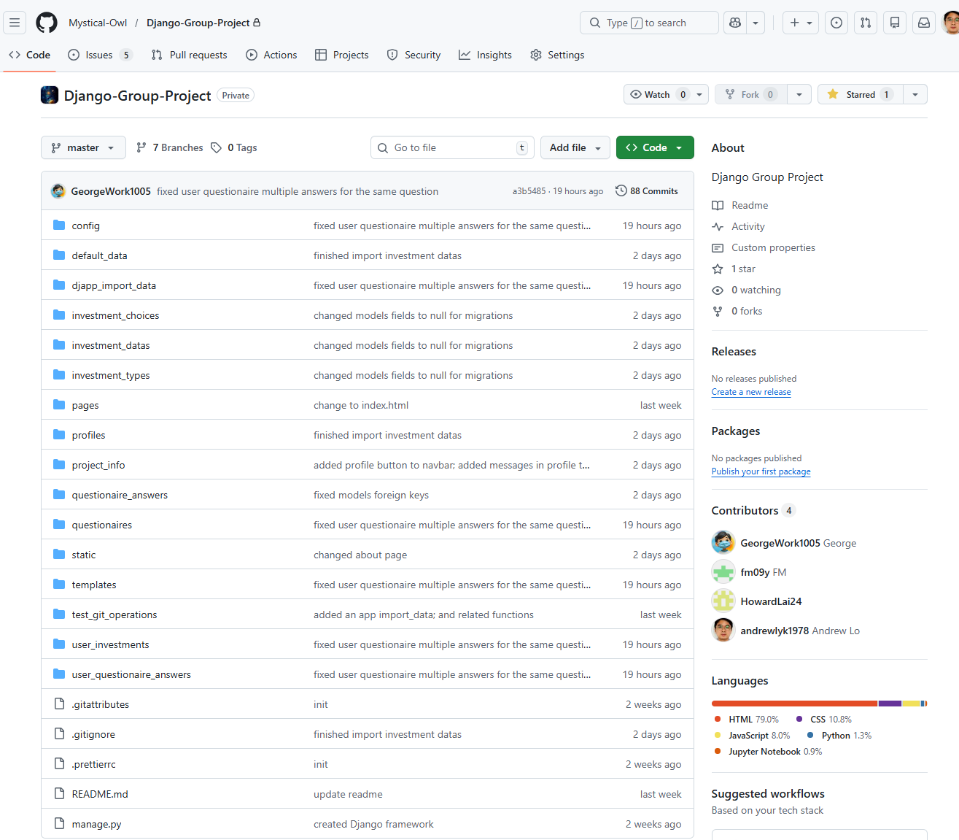
Django結構上 : Apps在 文 件 夾 按 英 文 字 排序,要特定位置收納安排 .

Slide 13
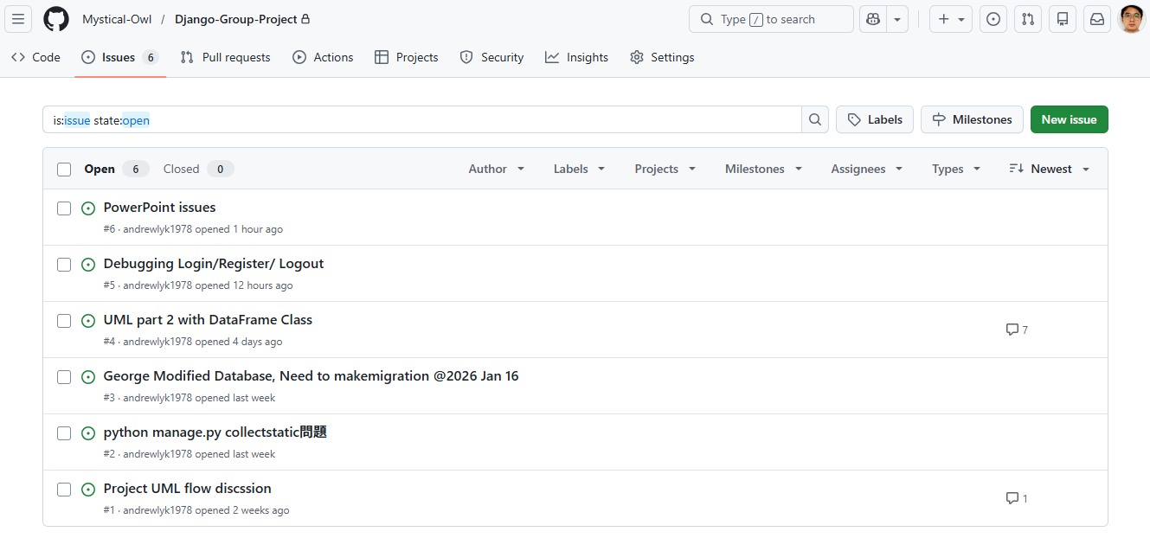
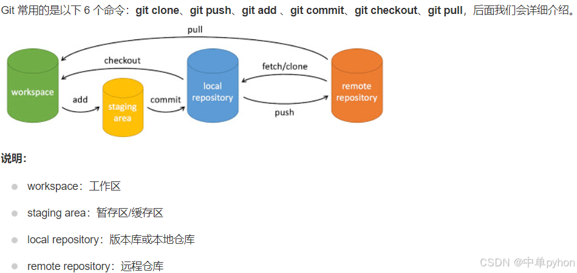
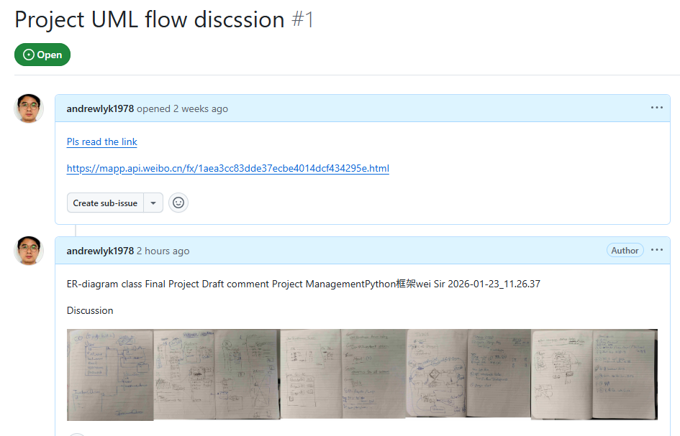

PM-項目管理:
GitHub ,Files Version management
GitHub, Create Issues, https://github.com/Mystical-Owl/Django-Group-Project/issues

Slide 14
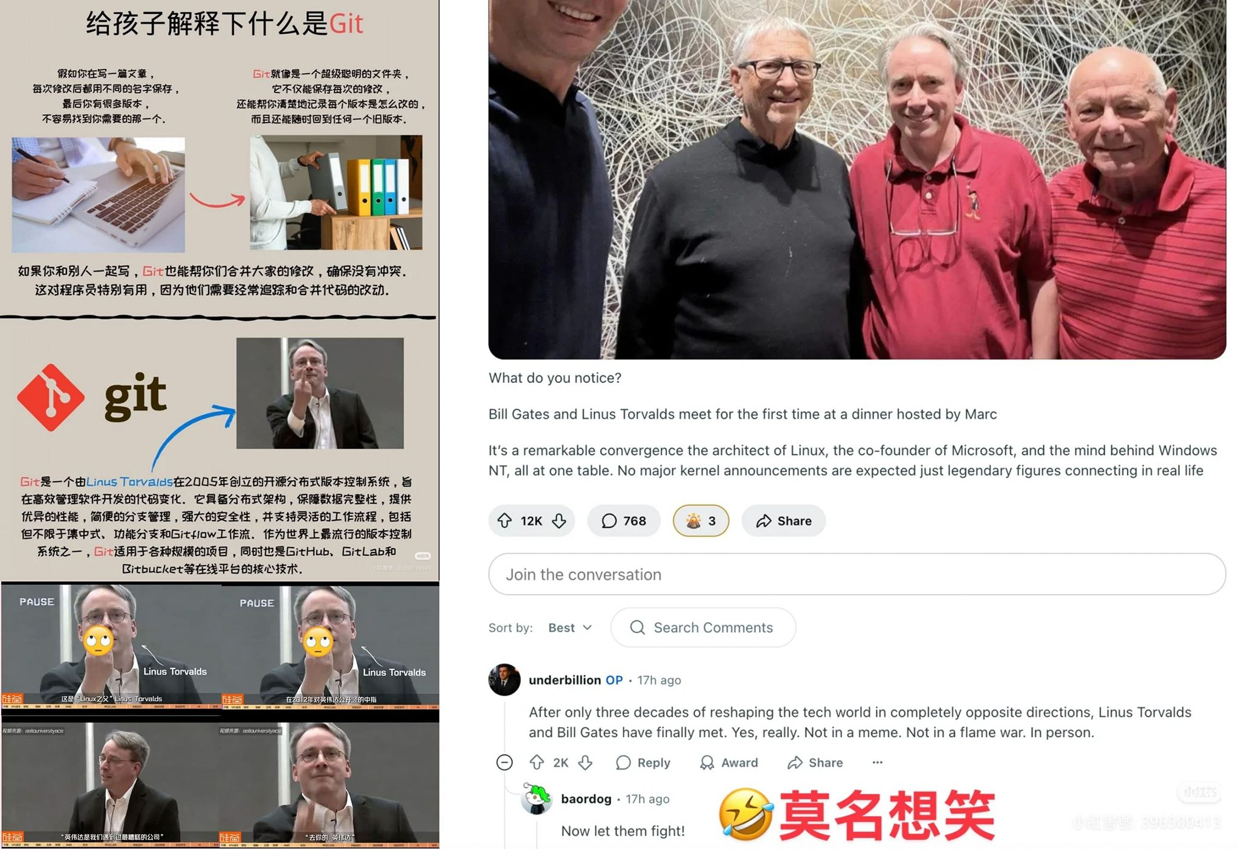
多謝Linus Torvalds
Linus vs Nvidia

Slide 15
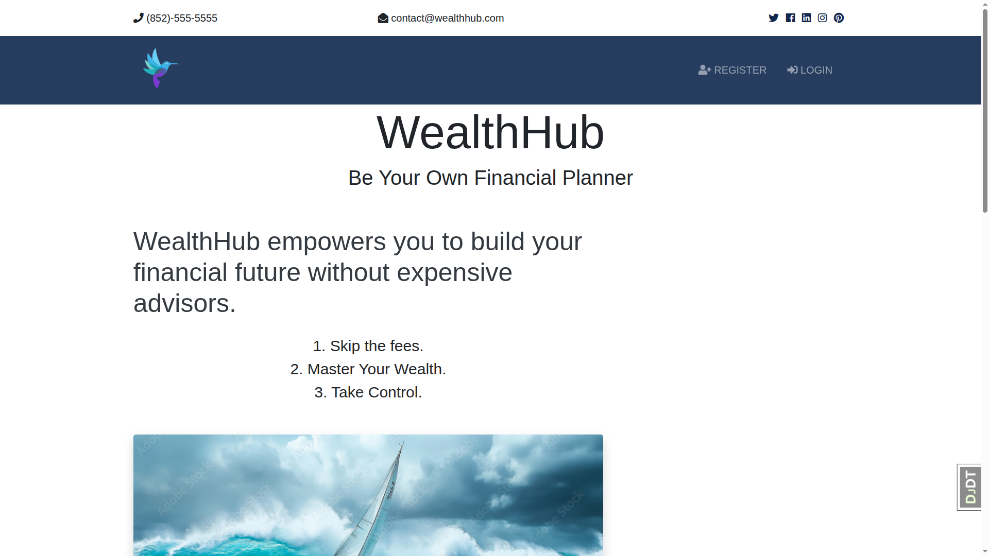

Slide 16
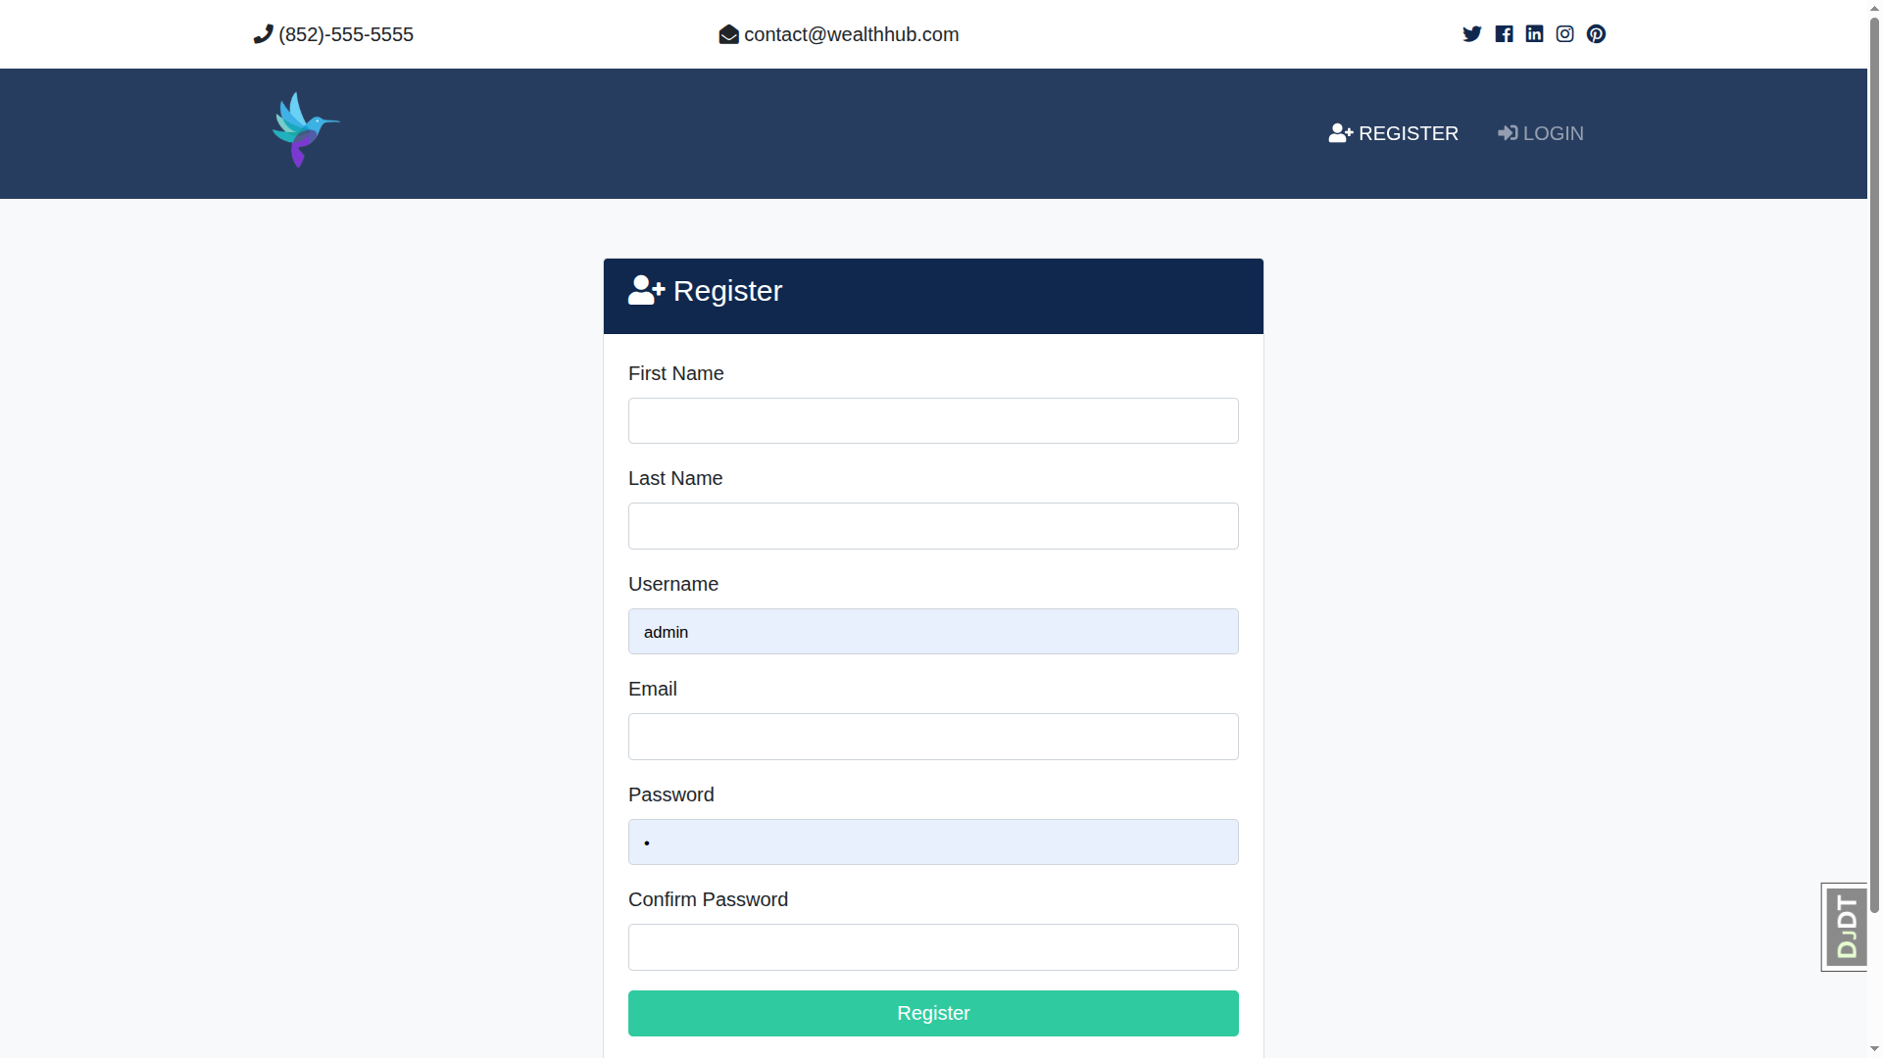

Slide 17
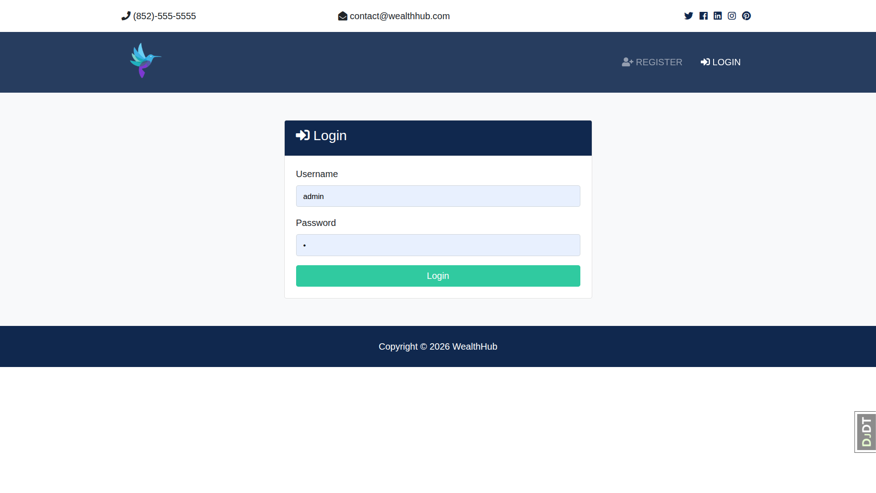

Slide 18
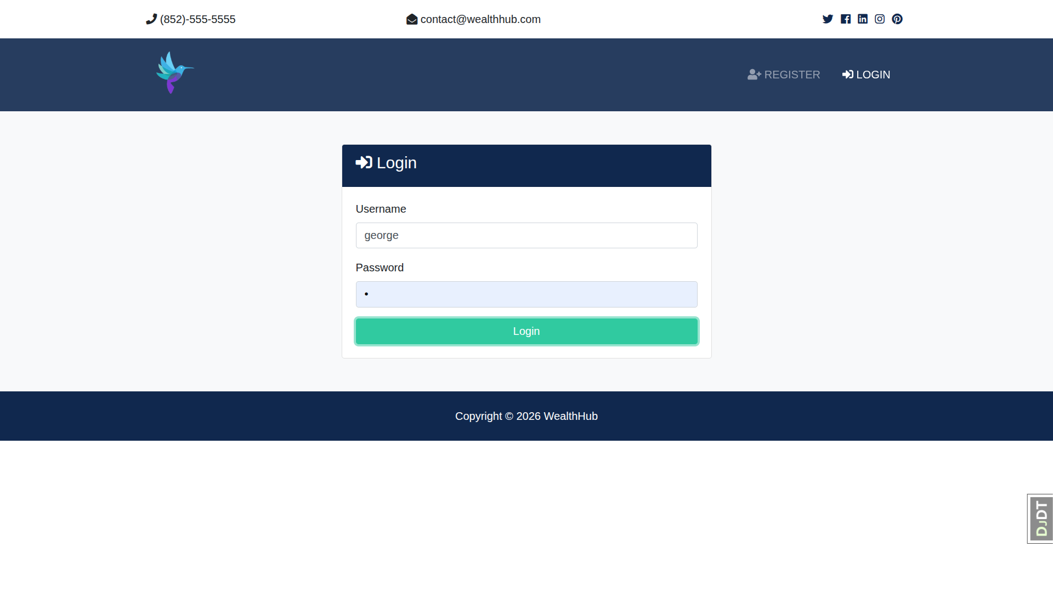

Slide 19
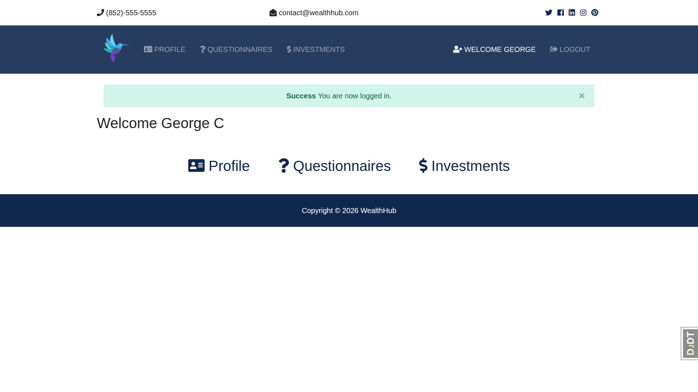

Slide 20
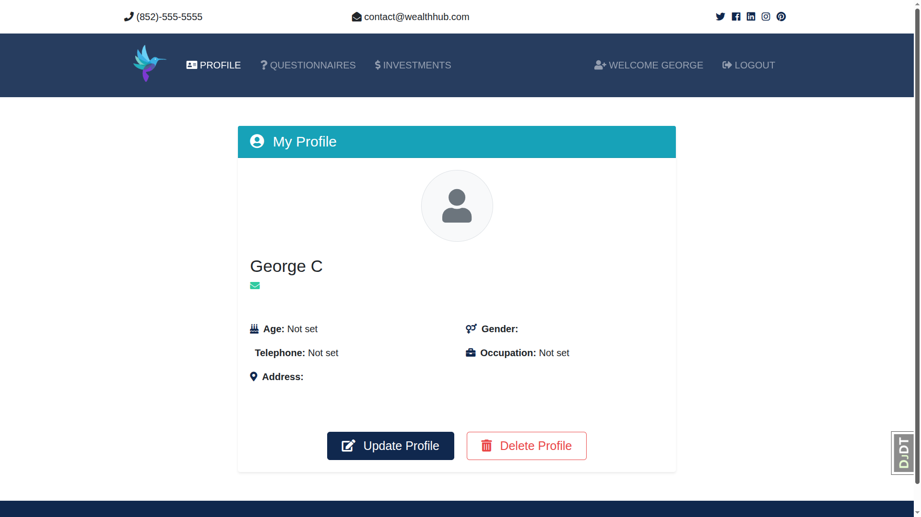

Slide 21
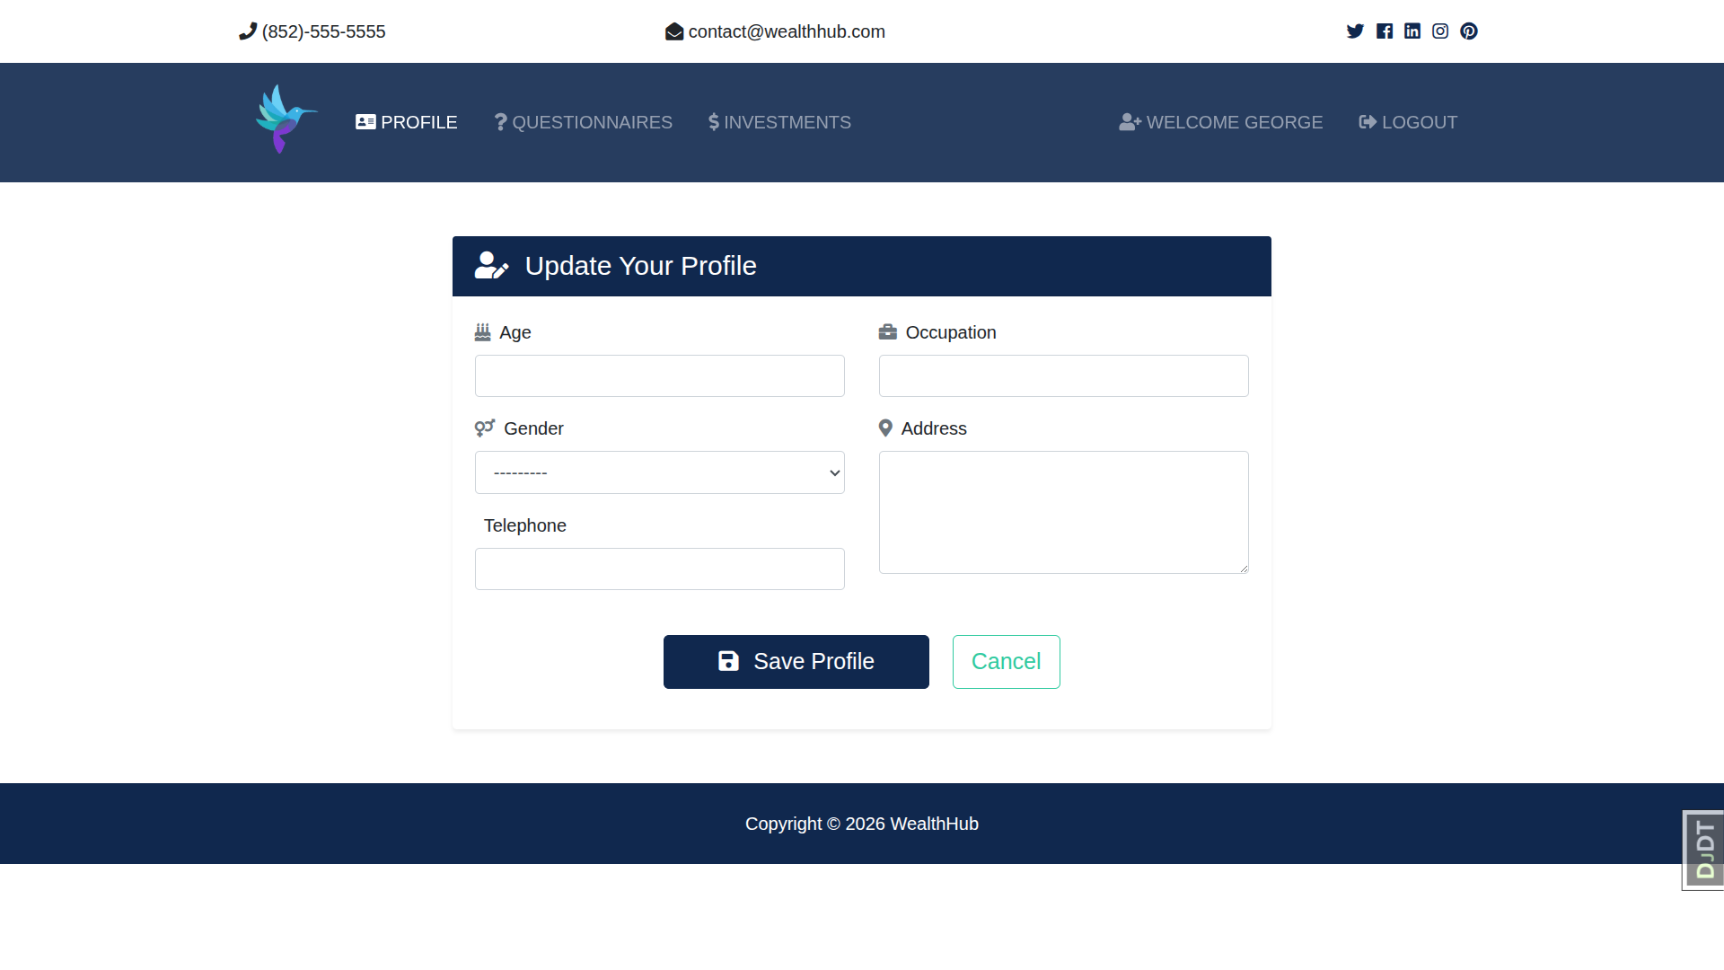

Slide 22
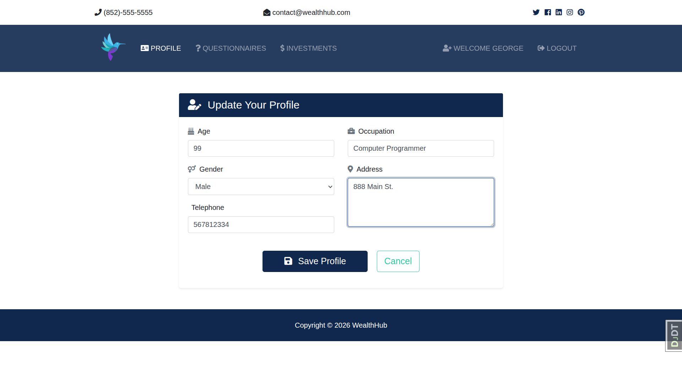

Slide 23
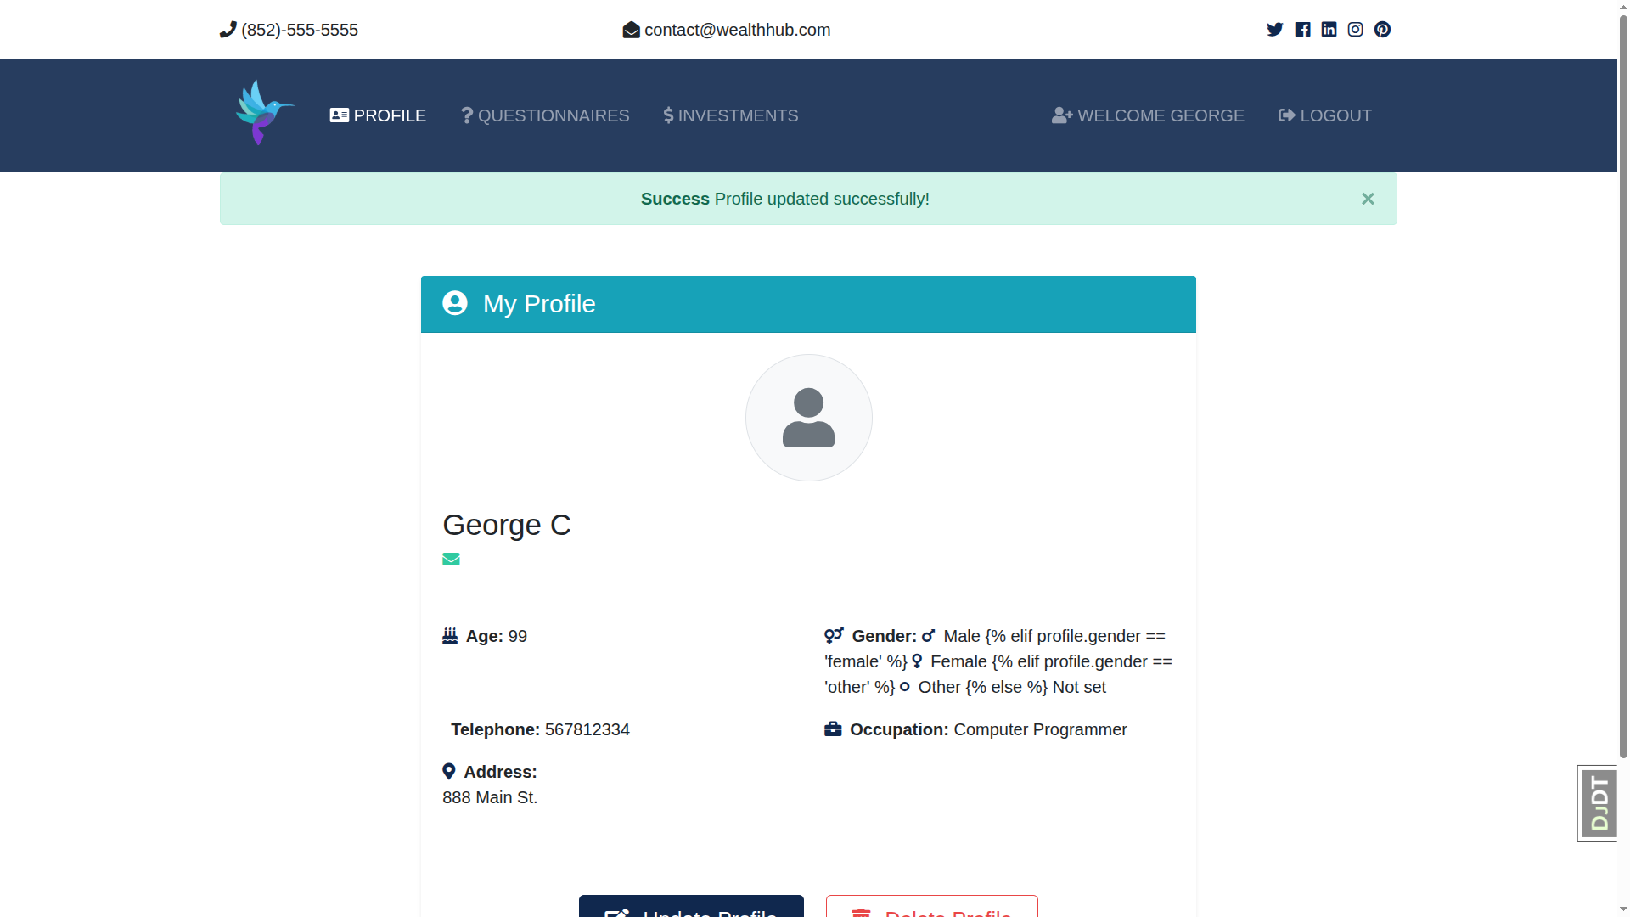

Slide 24
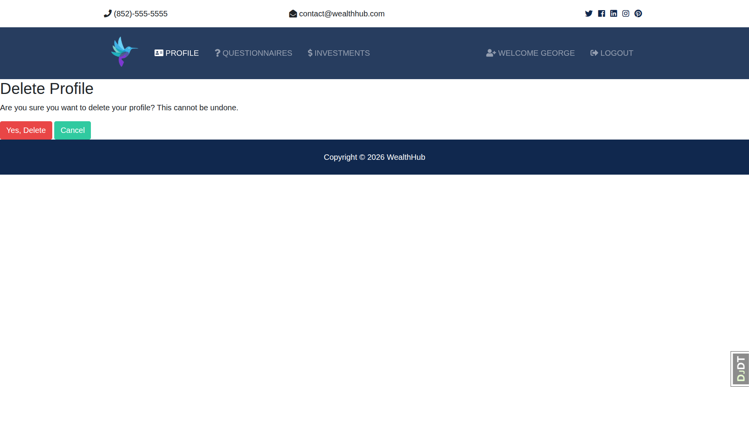

Slide 25
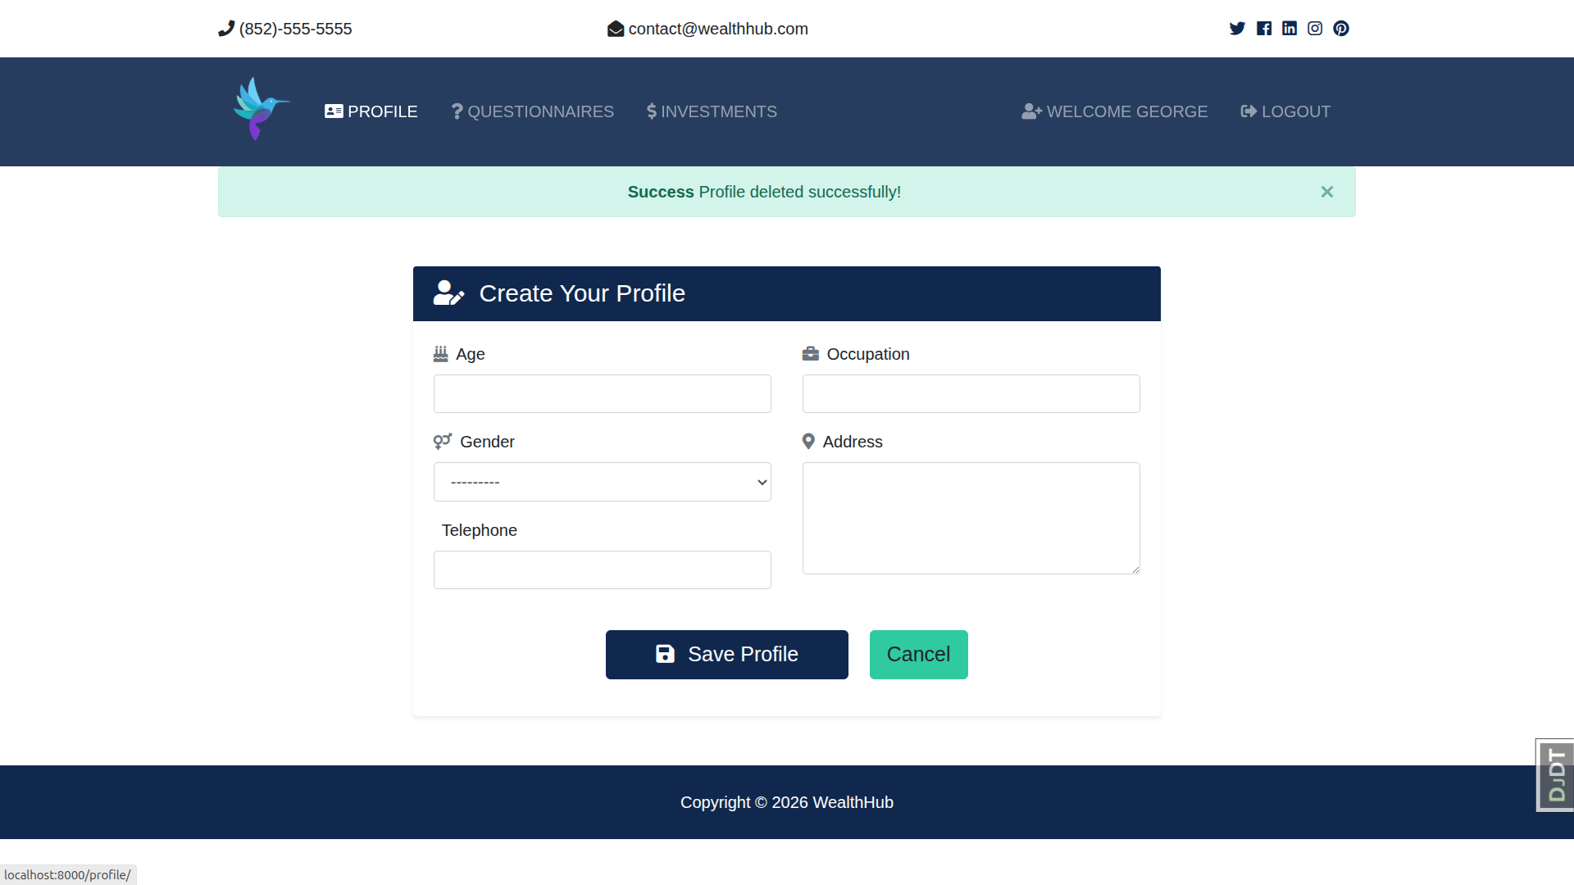

Slide 26
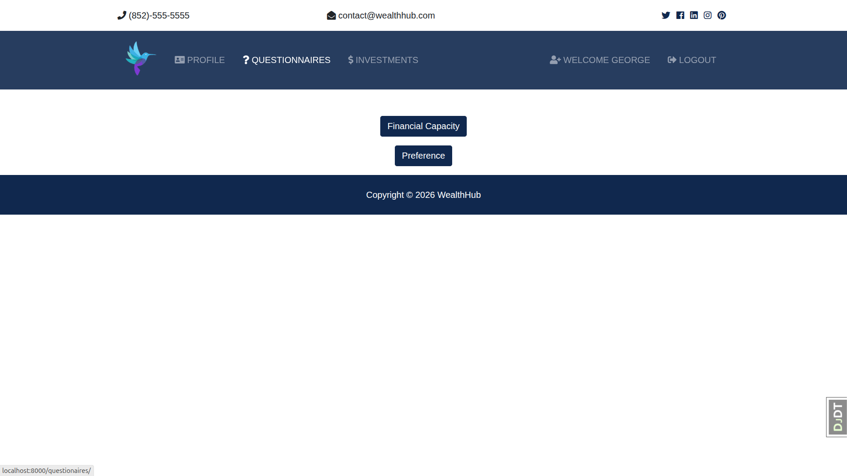

Slide 27
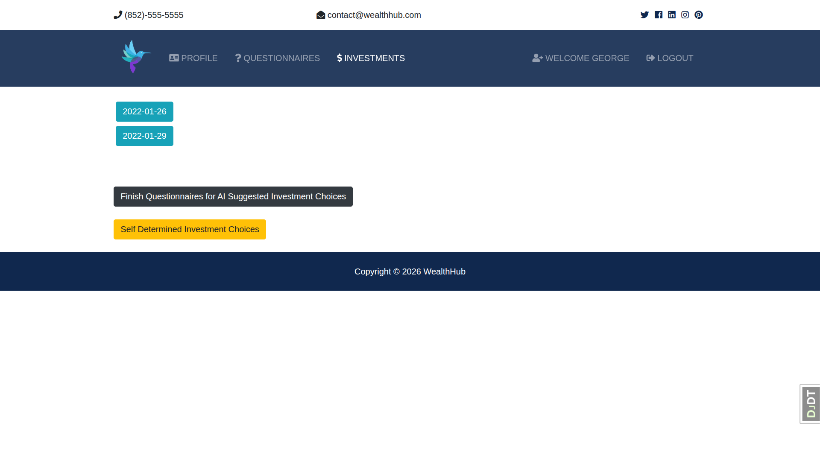

Slide 28
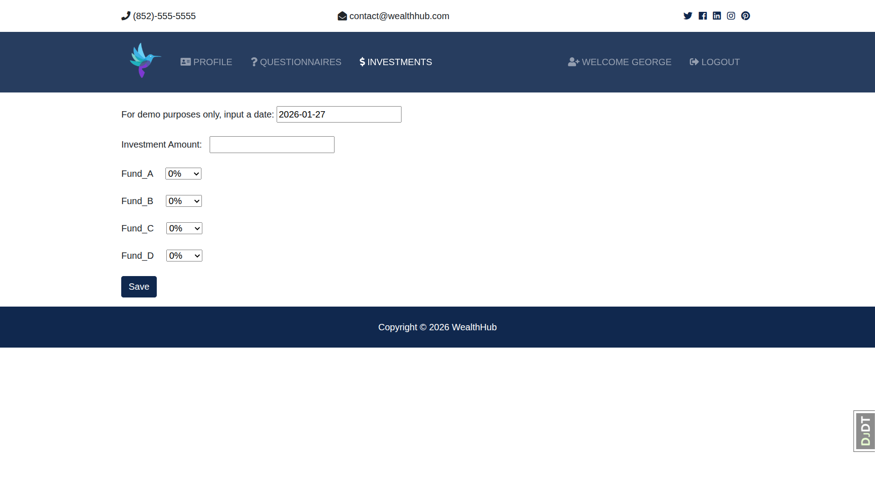

Slide 29
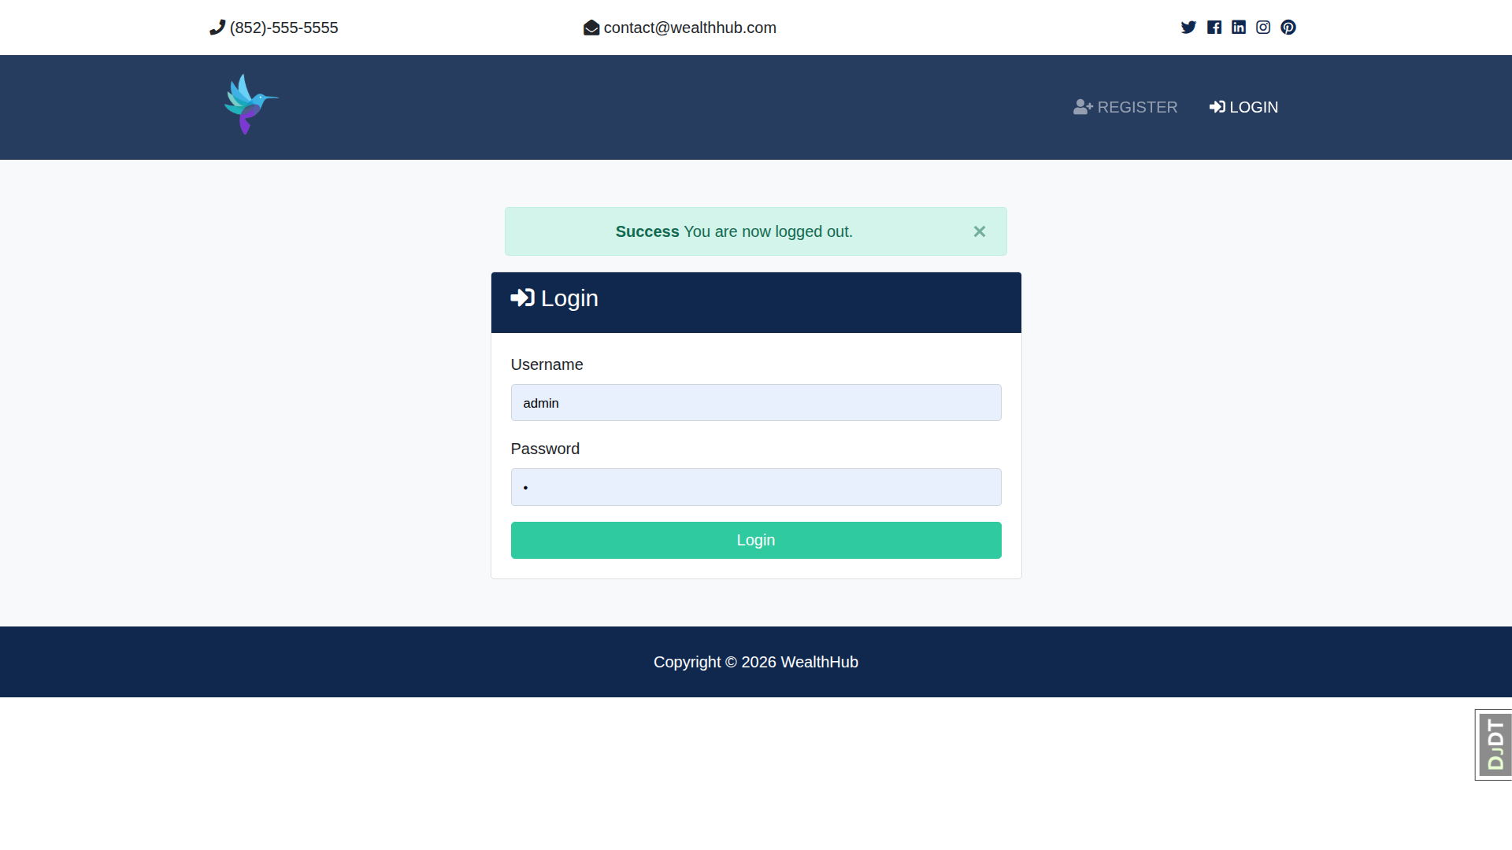

Slide 30
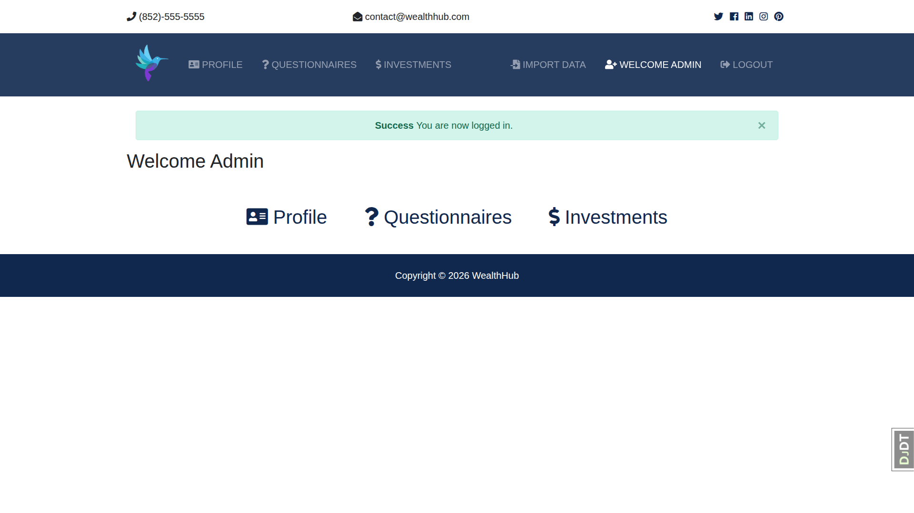

Slide 31
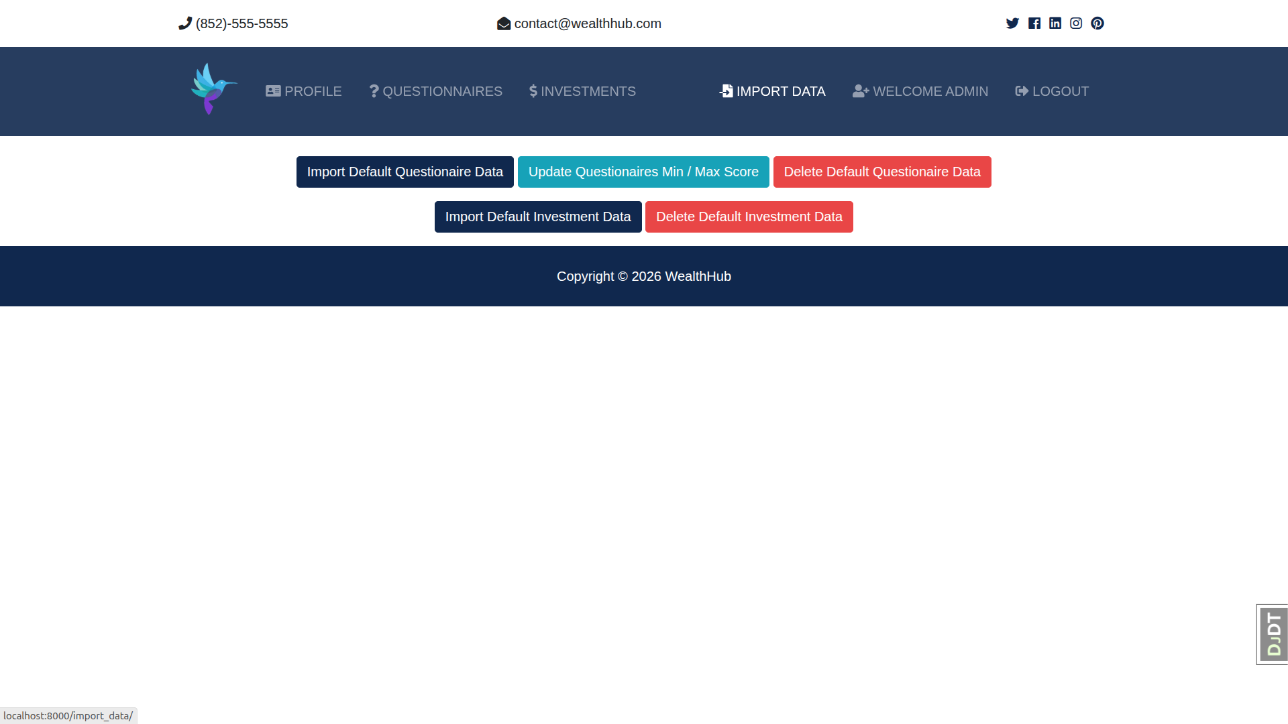

Slide 32
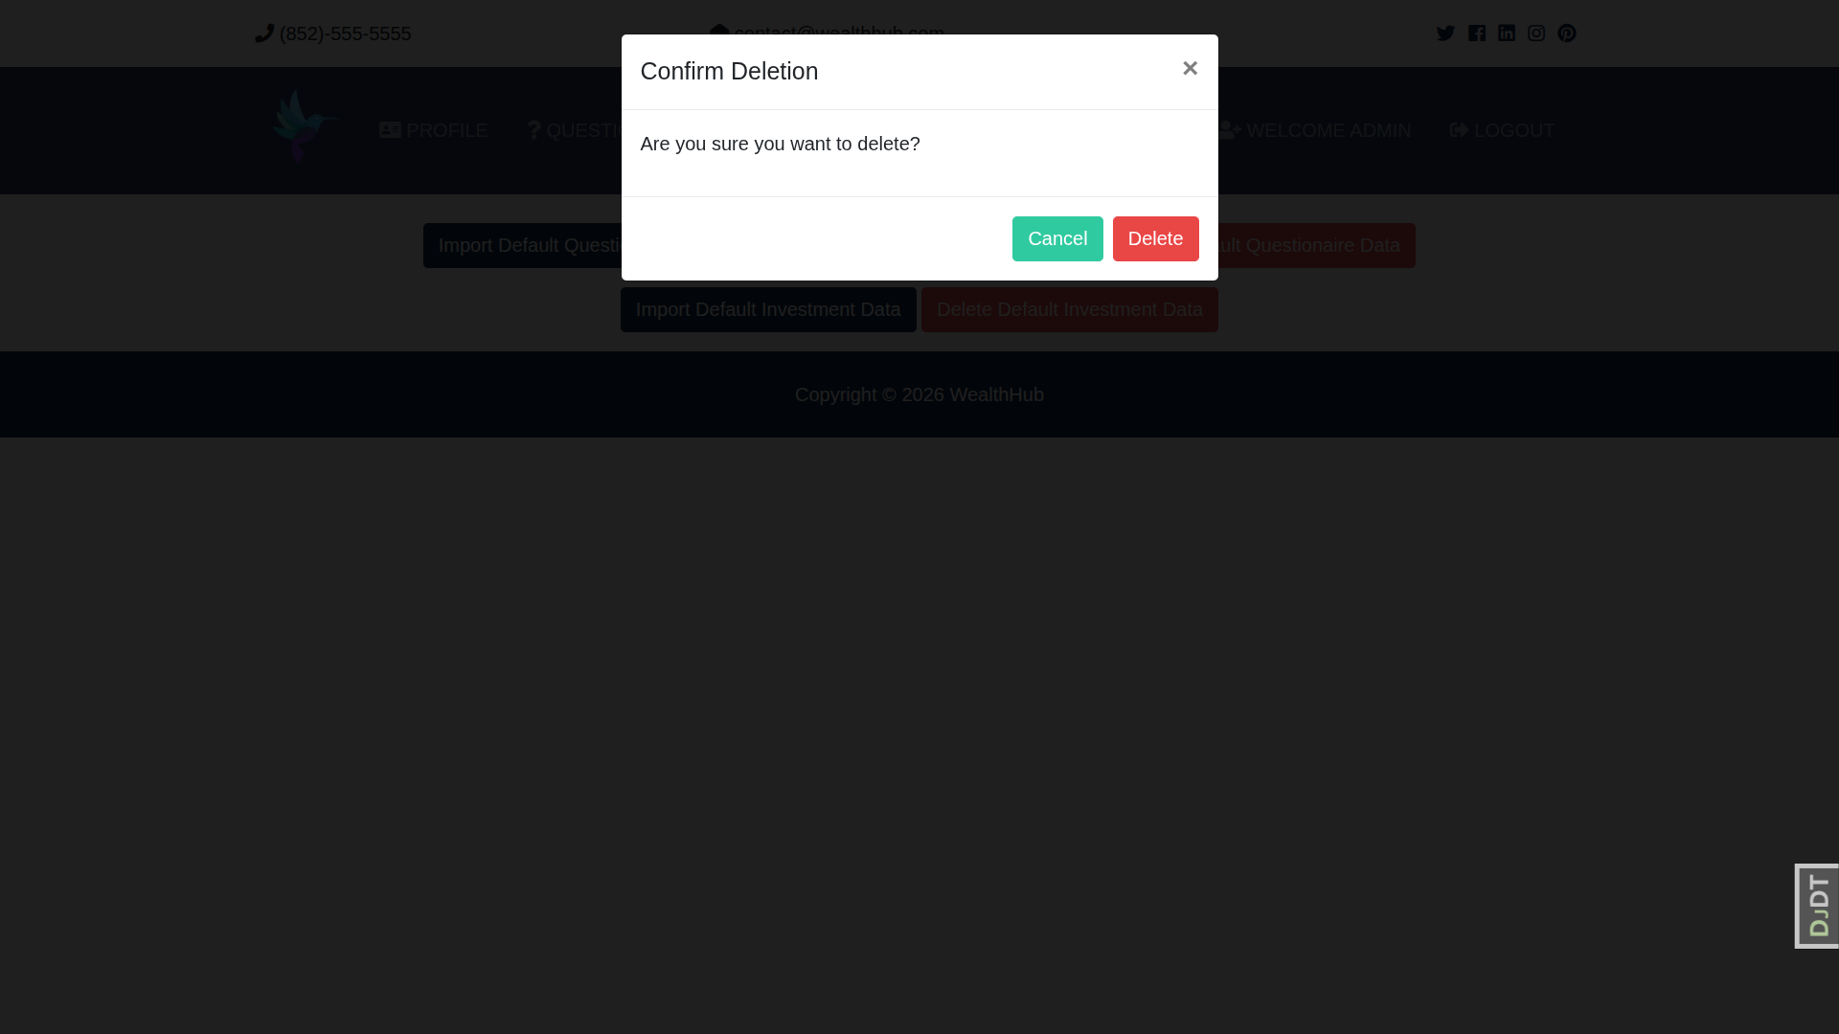

Slide 33
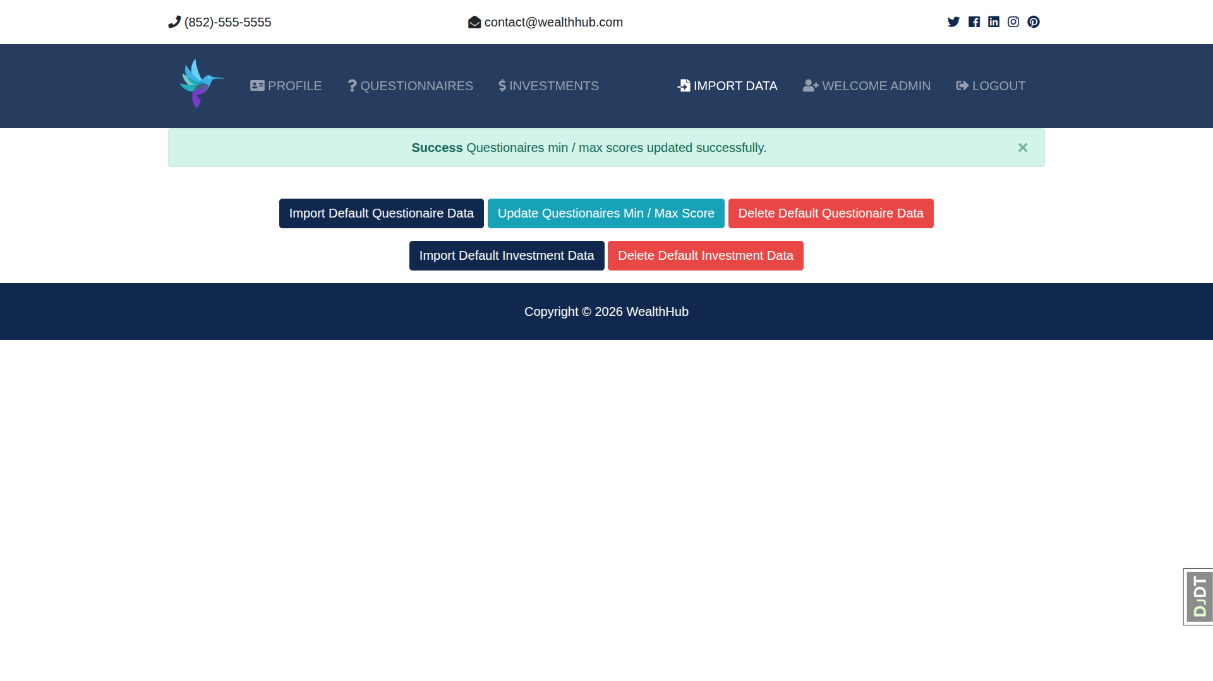

Slide 34

Technical and Program Issues
System Stability
Data Security
Ensuring 99.9% uptime through redundant server architectures and continuous monitoring of AI processing loads.
Implementation of bank-grade encryption and strict compliance with international financial data protection standards.
Algorithmic Integrity
API Integration
Regular auditing of AI models to prevent bias and ensure the accuracy of portfolio recommendations.
Seamless connectivity with global market data providers for real-time insights and execution.

Slide 35
Future Development

Slide 36
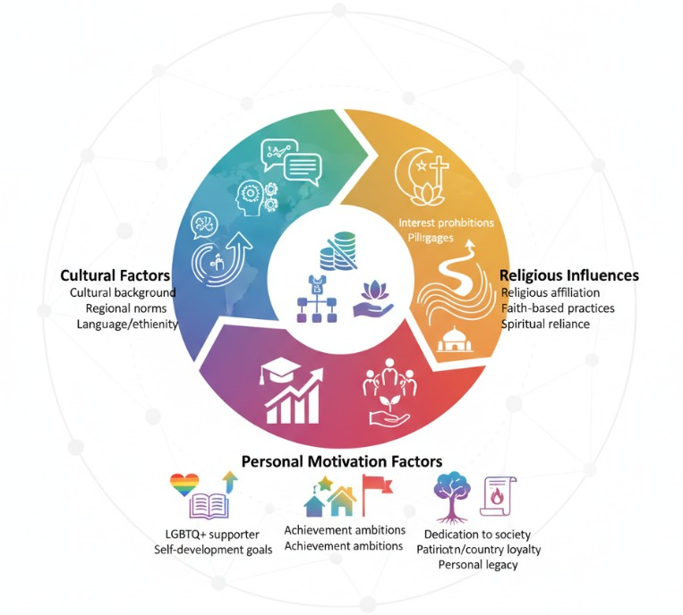
1. Global Demographic Expansion

Slide 37
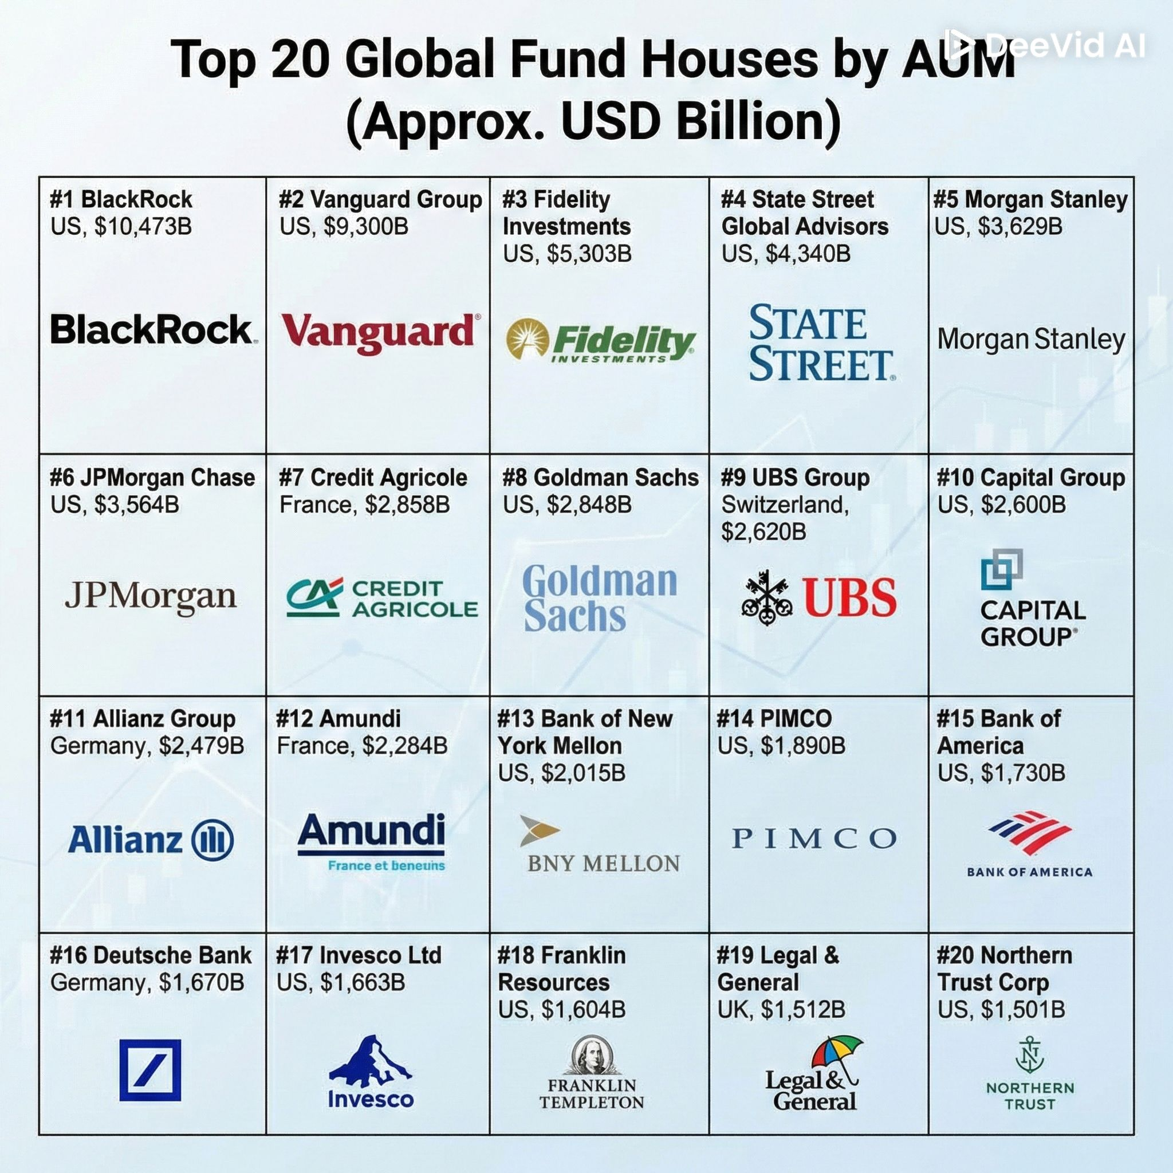
2. Expanded Portfolio Universe

Slide 38
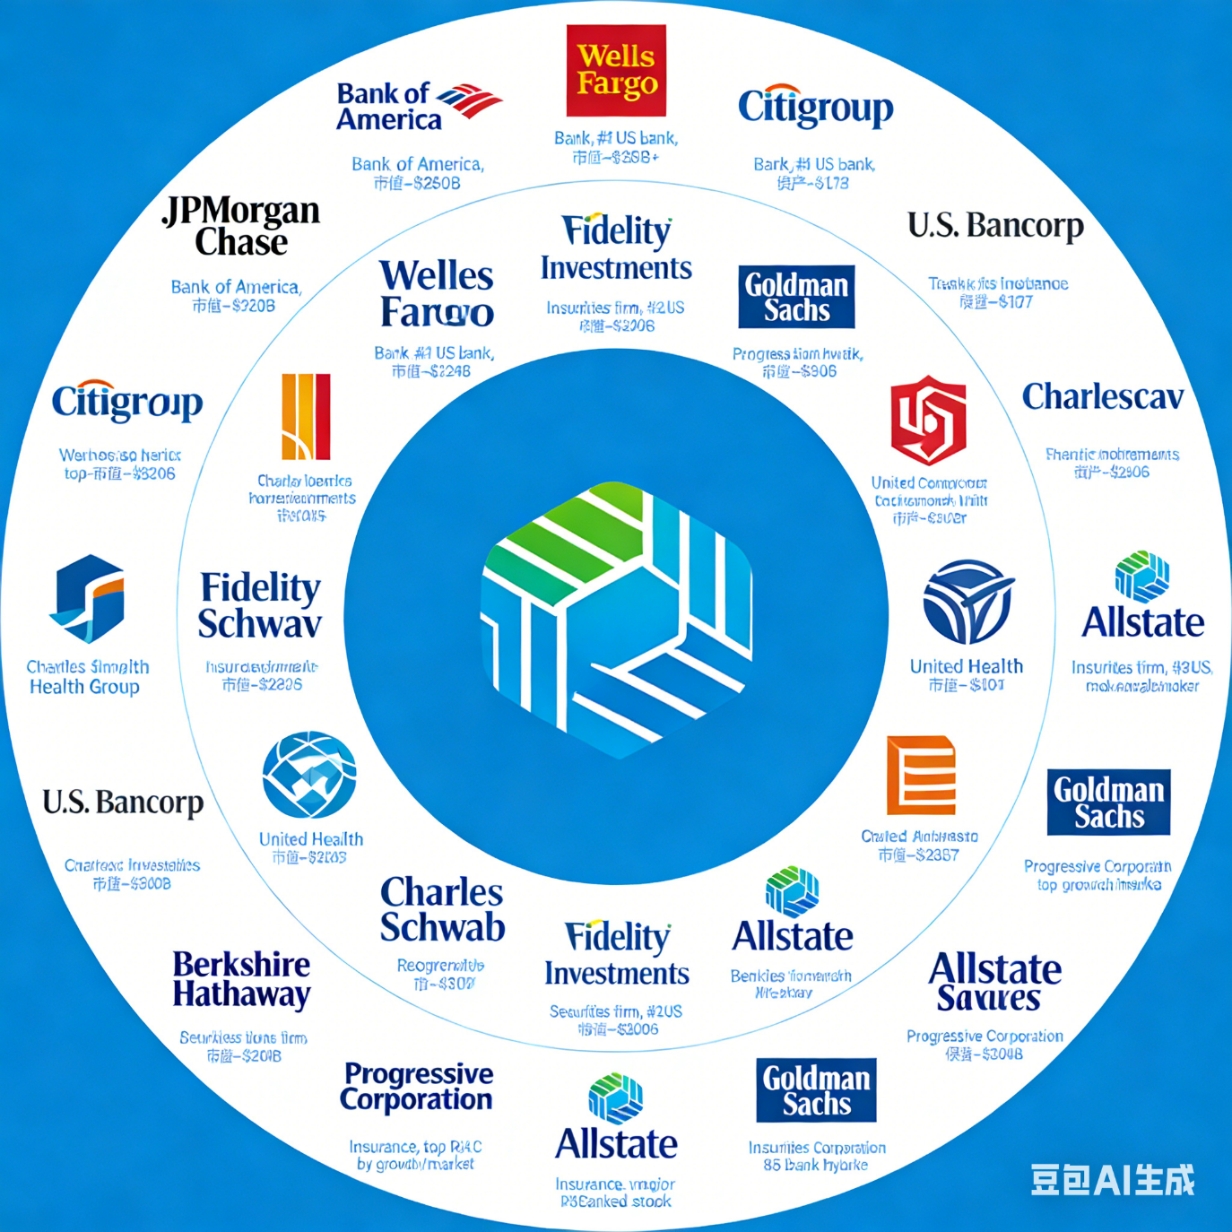
3. Strategic Institutional Partnerships
Leverage customer trust in our asset custody to forge alliances with banks, securities firms.

